Slide 1
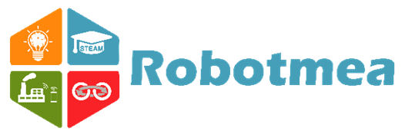
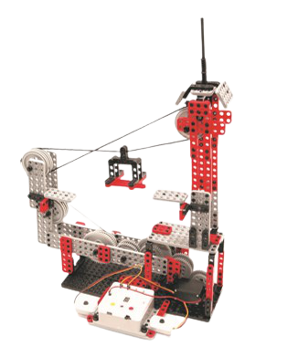
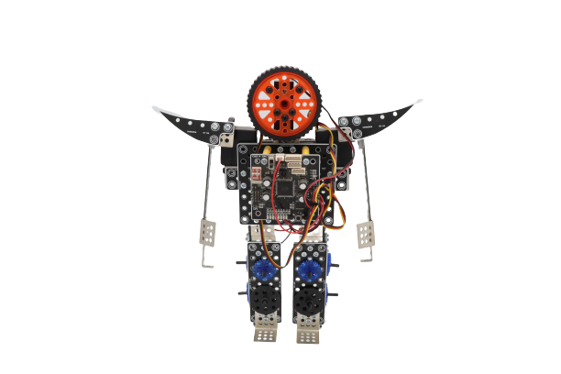
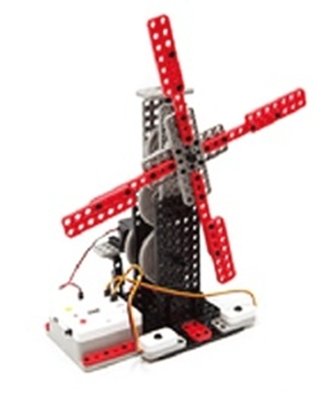
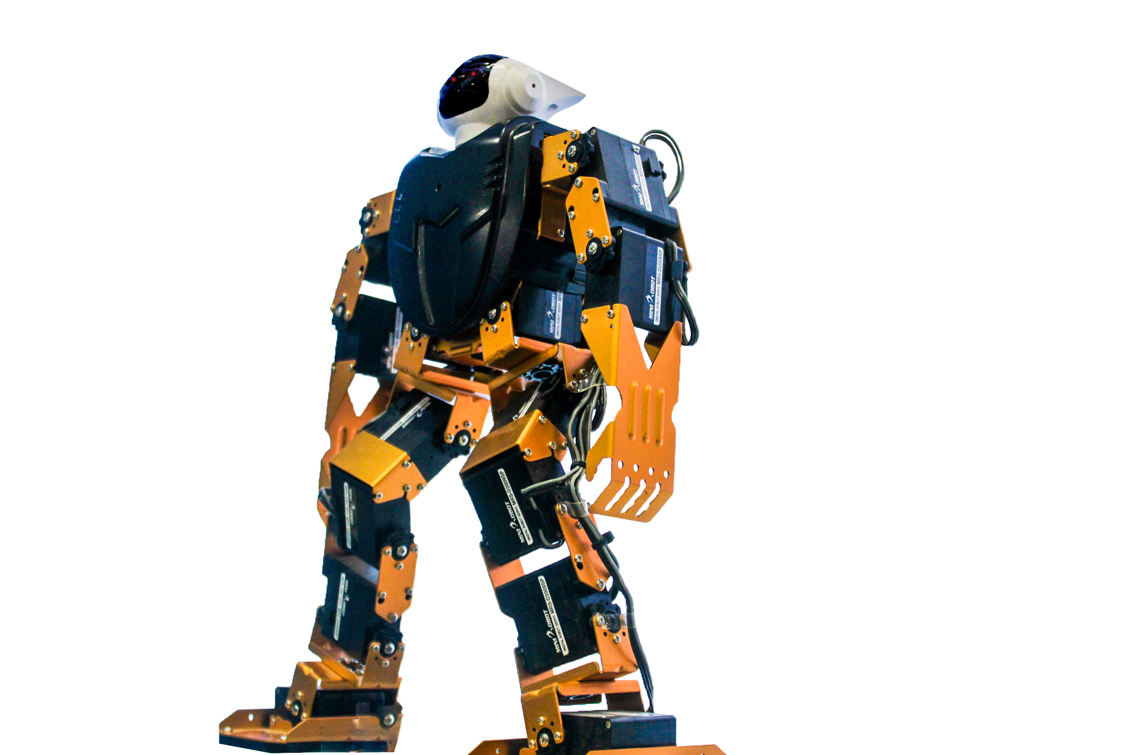
Transforming the Future of Youth
Robotmea Edutech PVT. LTD.
Innovative Education for Shaping Wisdom Driven Societies

Slide 2
Transforming the Future of Youth
Robotmea Capability Overview:
Who We Are:
A leading global EdTech Research & Development organization shaping the future of learning through innovation, research and technological advancement.
Backed by 3 R&D centers in South Korea and 2 R&D centers in China, Robotmea serves as a catalyst for educational transformation worldwide.
Enablement & collaboration hub in Dubai, UAE.
Management Office is in Pakistan H-13, Islamabad and second office is in Karachi.
AI· Robotics· IoT· AR/VR· Astronomy Sciences· STEAM· Emerging Technologies — built into K-12 and Higher Education.
Robotmea empowers educational institutions to cultivate innovation, critical thinking, creativity, and workforce readiness for the rapidly evolving digital era.

Slide 3
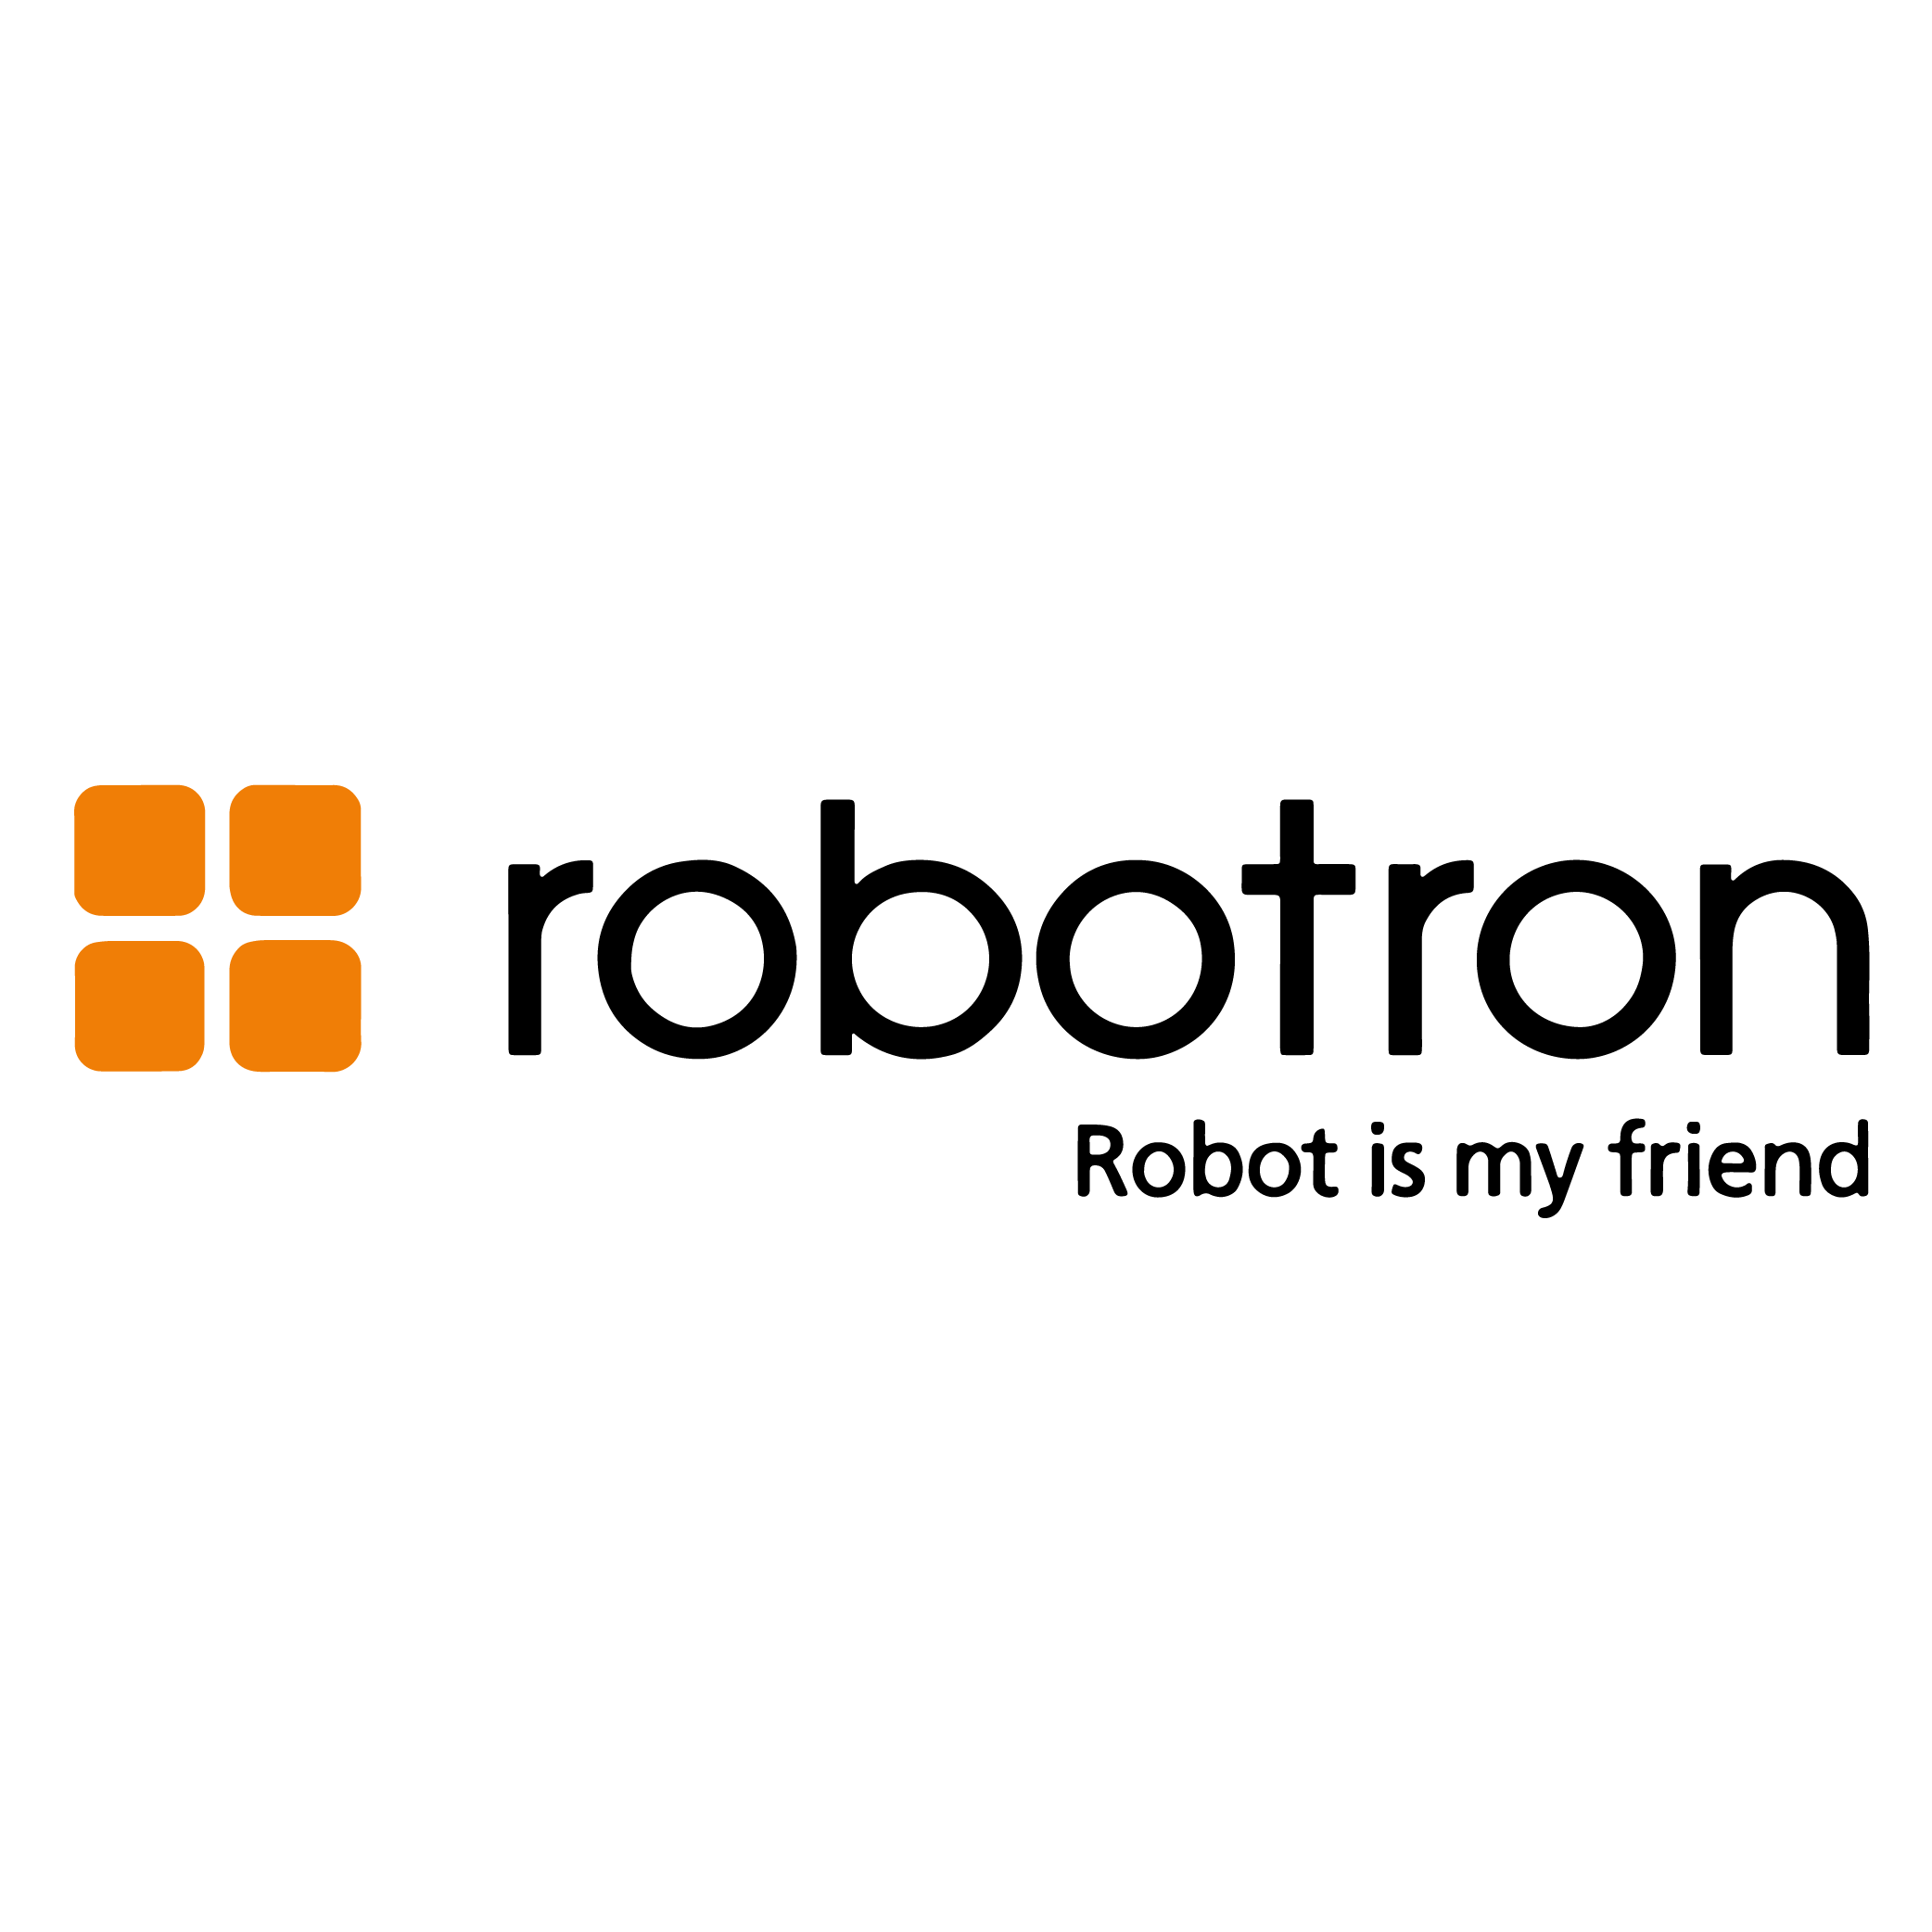
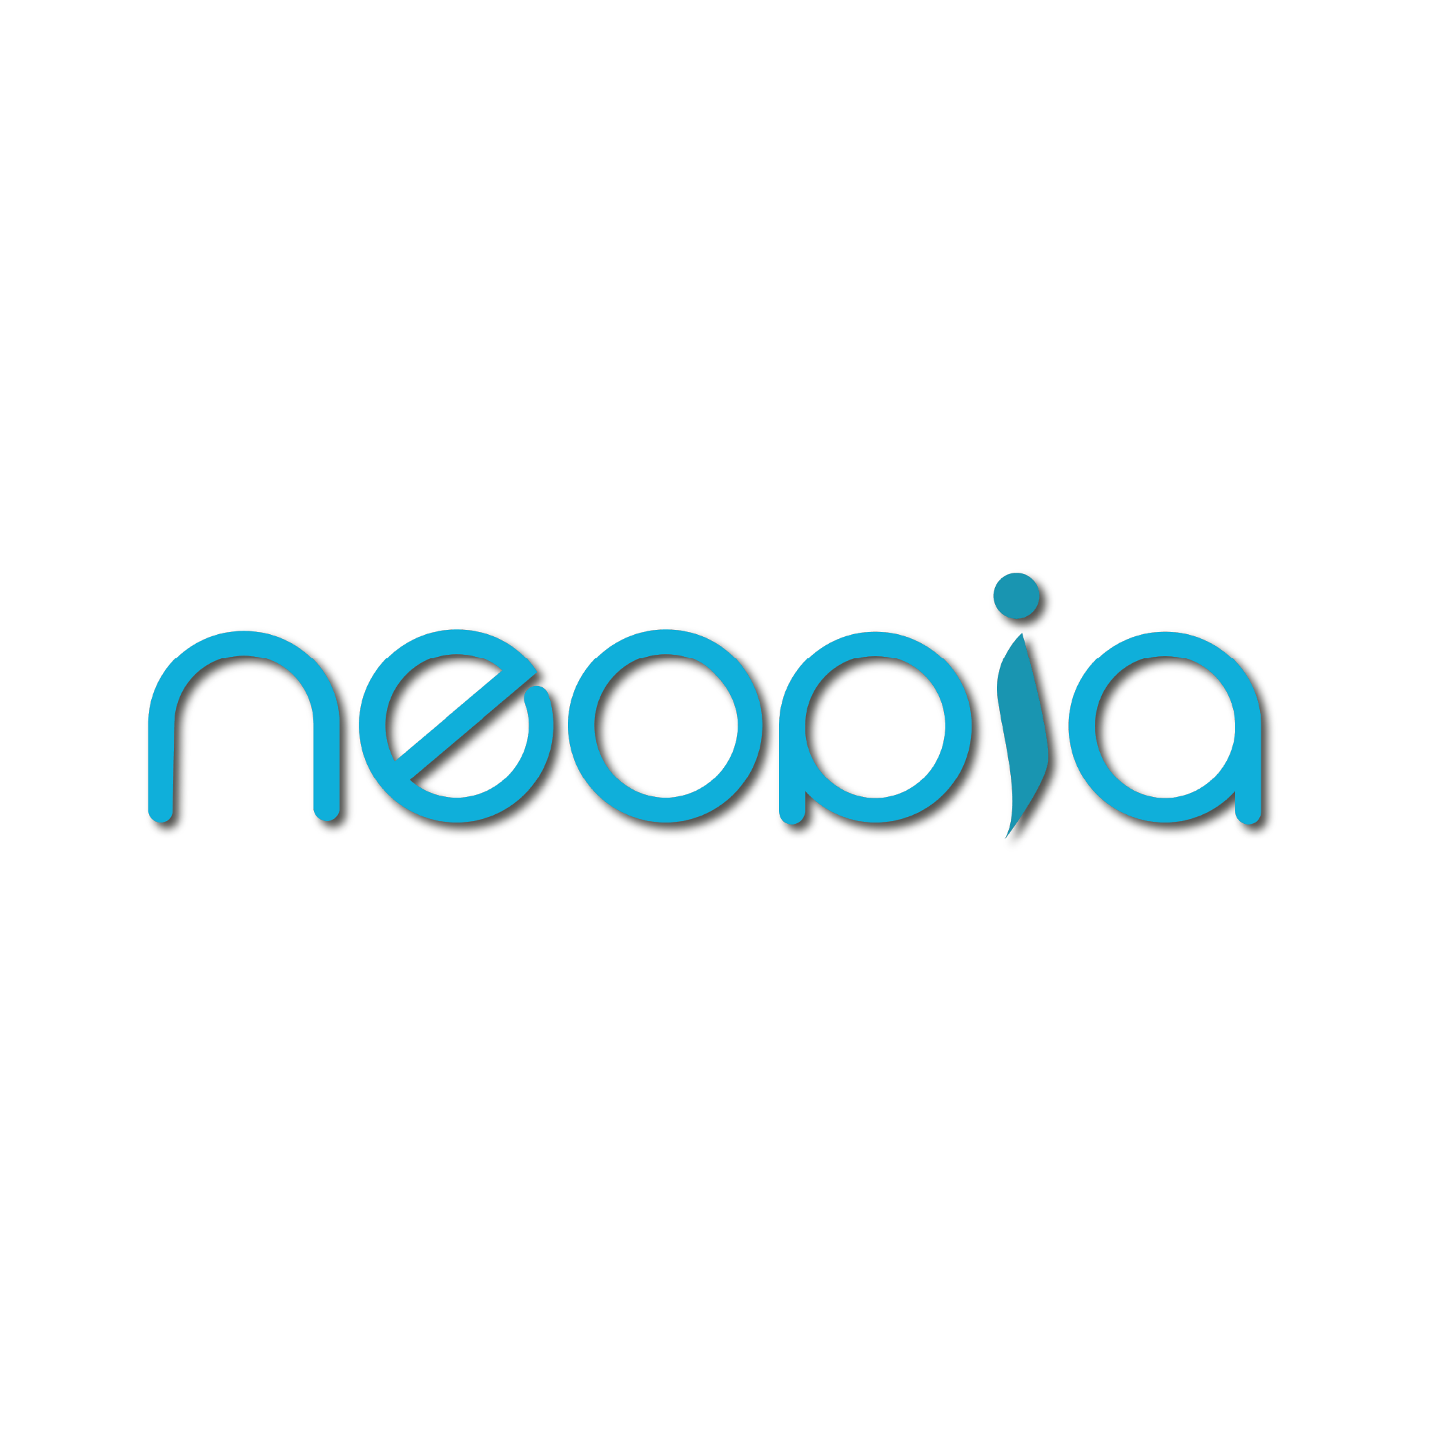
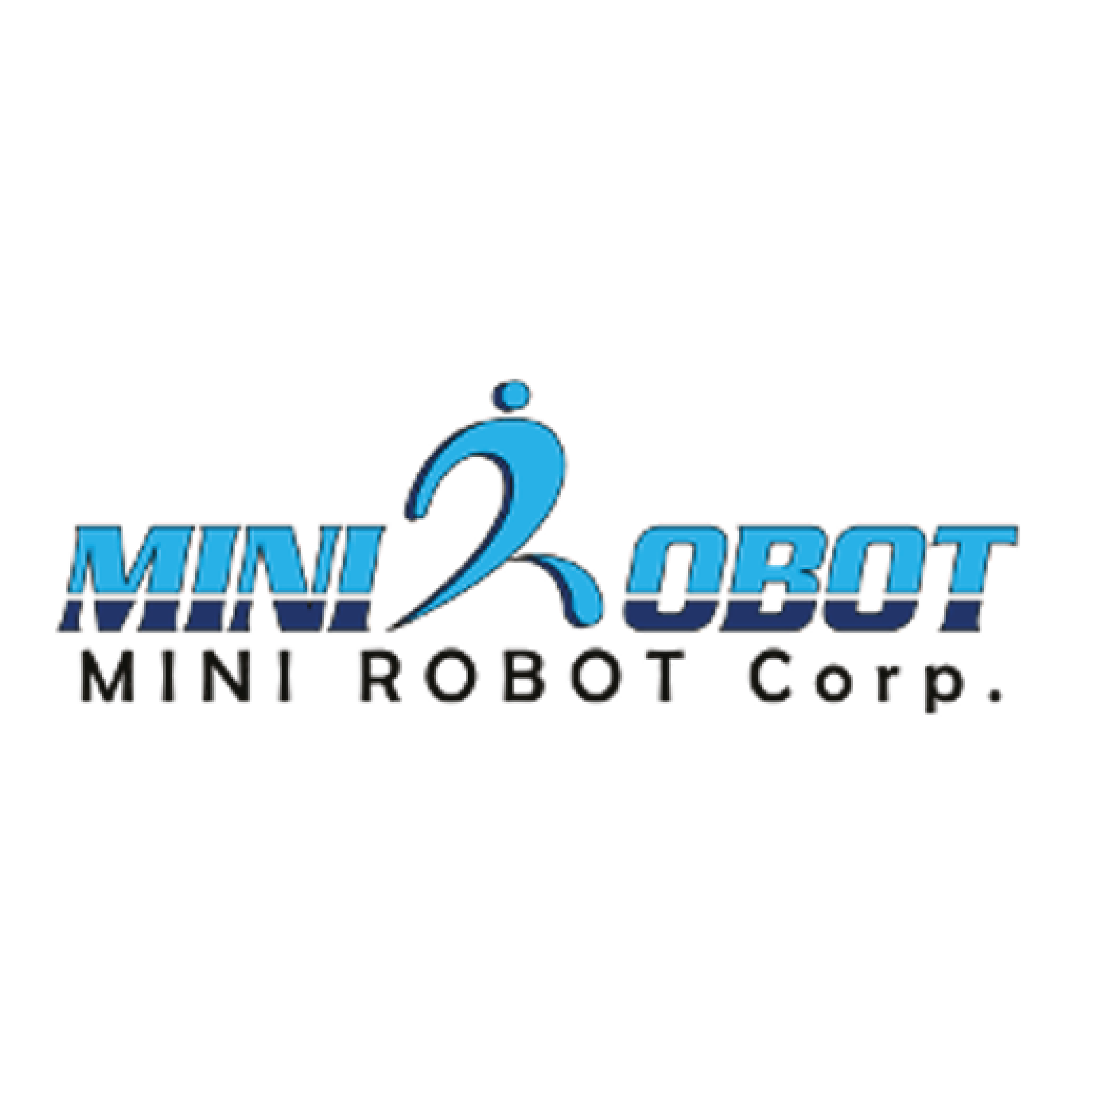

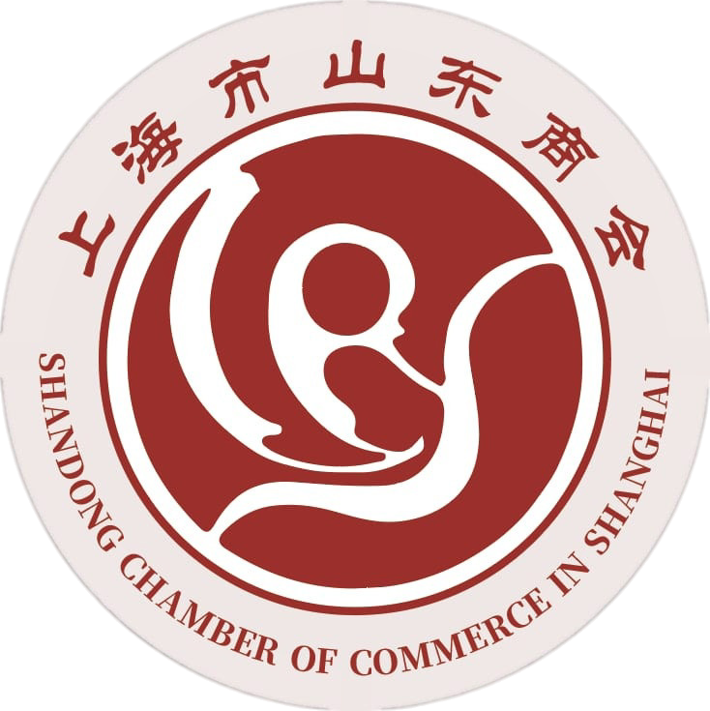
Transforming the Future of Youth
Titans of EdTech : Our International Partners
Robotron:
25 years of experience, selected by the Korean government for next-generation robotics R&D and adopted across Korea’s public schools as the reference STEAM platform.
Neopia:
27 years of experience, selected for the Ministry of Knowledge Economy’s Next-Generation Digital Leader Development Program.
Minirobot:
26 years of experience, designer of educational humanoid and provides competition-grade robotics platforms.
Sinion & Shandong Chamber of Commerce in Shanghai:
Provide cutting edge technologies required for Pakistan.

Slide 4
Transforming the Future of Youth
Robotmea: Aspire to Inspire
Robotmea is an international edtech research and development organization working in Middle, East, Africa & Pakistan for transforming education through technology, innovation and entrepreneurship with special focus on Artificial Intelligence, Robotics, Internet of Things and Emerging Technologies.
Vision: Transforming the Future of Youth
Strategic Objective: Innovative education for shaping wisdom driven economies.
Robotmea is deeply rooted in Islamic values like uncompromising commitment to integrity, transparency, accountability & meritocracy, innovation & creativity, continuous research & development, excellence in quality, pragmatism, respect and trust.

Slide 5
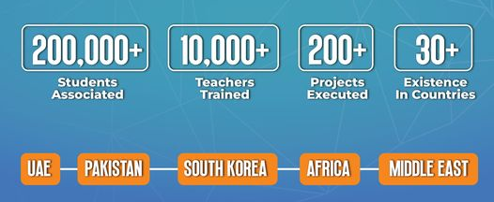
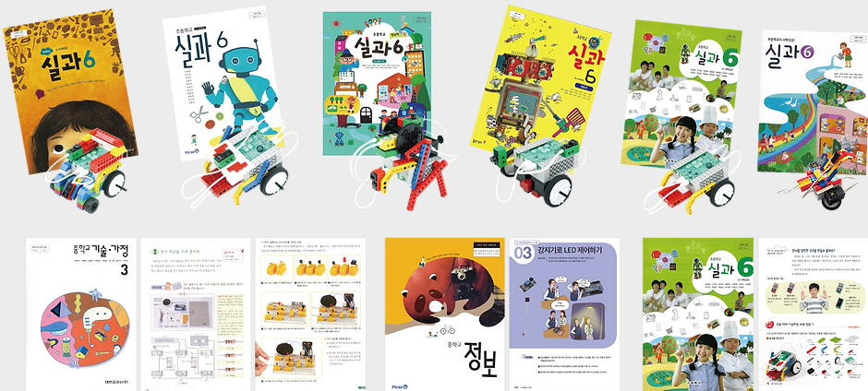
Transforming the Future of Youth
Trust us we know Global Edtech Industry!!! Alhamdulilah
Robotmea International in collaboration with its Partners in South Korea are
Advisor & Partner of South Korea government for Robotics & STEAM Education
Joint R&D Centre operators with Government of South Korea for Robotics & STEAM Education
Robotmea partner’s product in National Korean Textbooks
Turnkey Solution provider to Korean Primary & Middle Year Government Schools including technology platforms, academic resource material and teacher’s training
Robotmea started its operation back in 2018 in Pakistan.

Slide 6
Transforming the Future of Youth
Robotmea Ecosystem:
1. Institute for Edtech Research, Development & Growth (IERDG):
It’s the Pakistan's first international EdTech research platform, launched with our international partner Robotron (South Korea) for popularizing EdTech and fostering a culture of technology-enabled learning across Pakistan’s educational landscape.
Robotmea
IERDG
COPR Nexus
2. Communication, Outreach & Public Relation Nexus (COPR Nexus):
It serves as a central platform for promoting innovation, building strategic partnerships, enhancing brand visibility, and amplifying the impact of educational transformation initiatives.

Slide 7
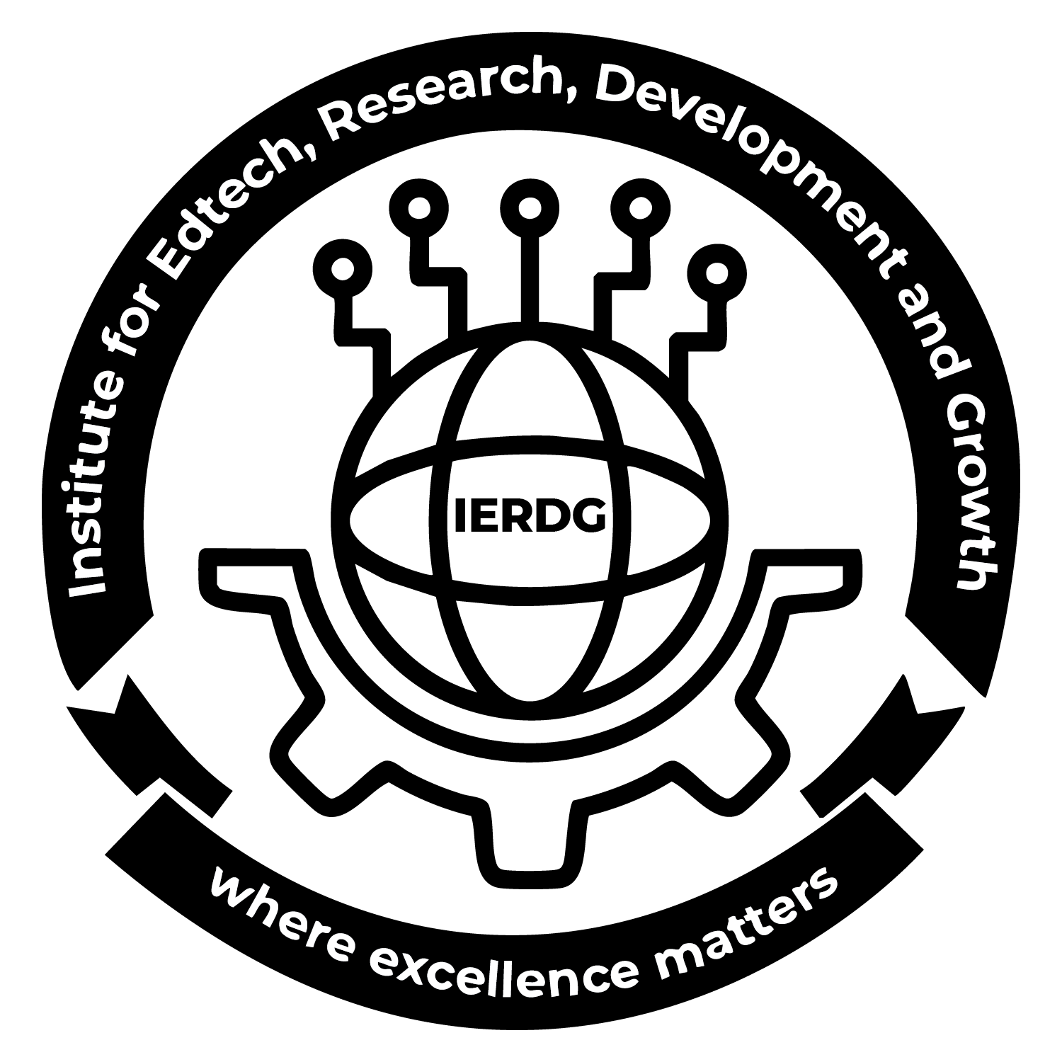
Transforming the Future of Youth
Institute for Edtech Research, Development & Growth (IERDG):
A research and innovation hub advancing EdTech across Pakistan and beyond.
Research & development in emerging learning technologies.
Academic collaborations, publications & strategic partnerships and international certifications.
IERDG comprises of the following programs:
K-12 Program
Education Transformational Movement (ETM)
Robotmea Emerging Technology Center (RETC)
Faculty Development Cell (FDC)
International Diploma Program (IDP)

Slide 8
Transforming the Future of Youth
1. K-12 Program:
A complete transformation initiative preparing schools for the future of learning.
Brings AI, Robotics, IoT, AR/VR, Astronomy, STEAM Education, emerging technologies & Entrepreneurship into existing curricula.
360-degree turnkey solutions for the schools to transform their educational landscape.
Two pathways:
Addition Model.
Integration Model.
Discovery & Innovation Hubs, faculty development, internationally aligned curriculum, monitoring and evaluation, refresher training and ongoing support throughout the program.
Builds creativity, critical thinking, problem-solving, communication skillset development & leadership.

Slide 9
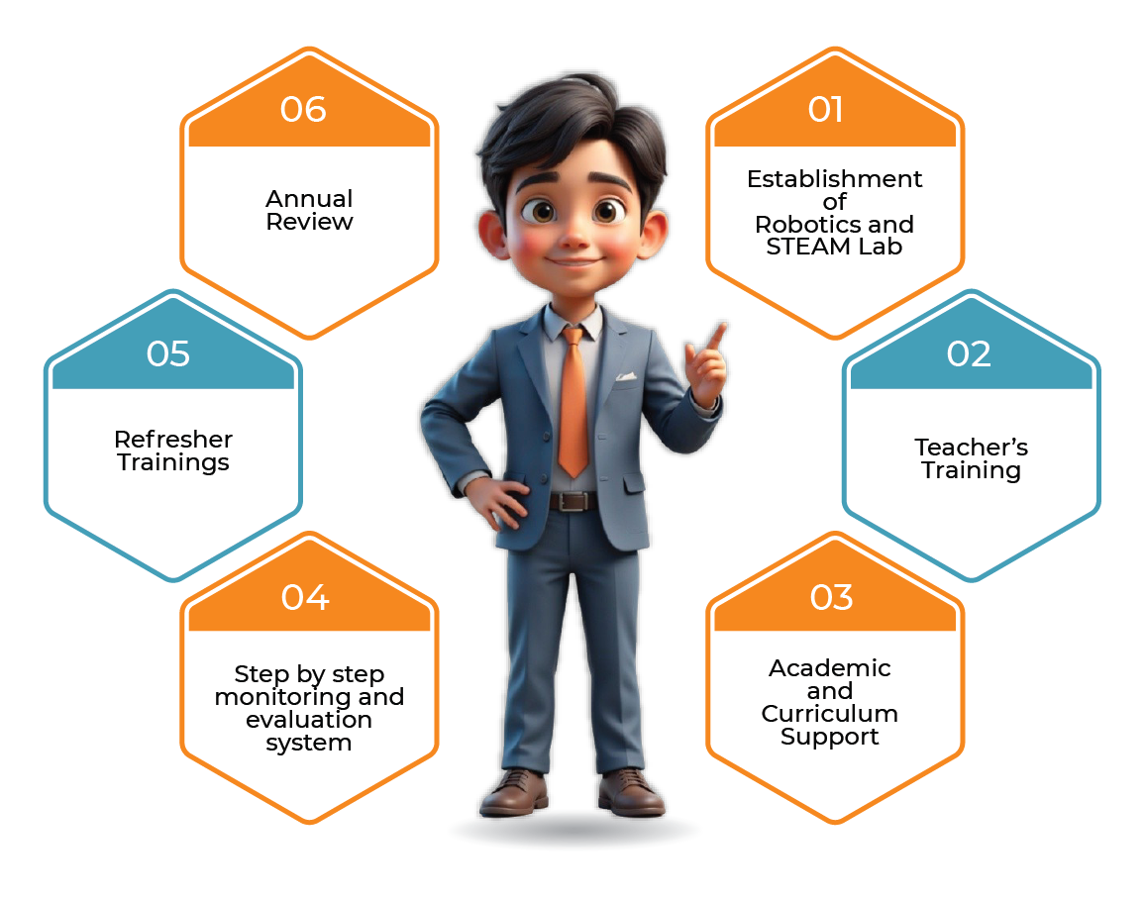
Transforming the Future of Youth
Addition Model:
Addition of AI, Robotics & Coding with STEAM educational framework in existing curriculum.
Development of AI, Robotics and STEAM Lab.
Provision of AI, Robotics and STEAM curriculum.
Training of Teachers & M&E.
Implementable from K–12.
Future-focused learning without modifying Schools’ current academic structure.
Develop technological literacy, innovation, creativity, and problem-solving skills through hands-on experiences and project-based learning.

Slide 10
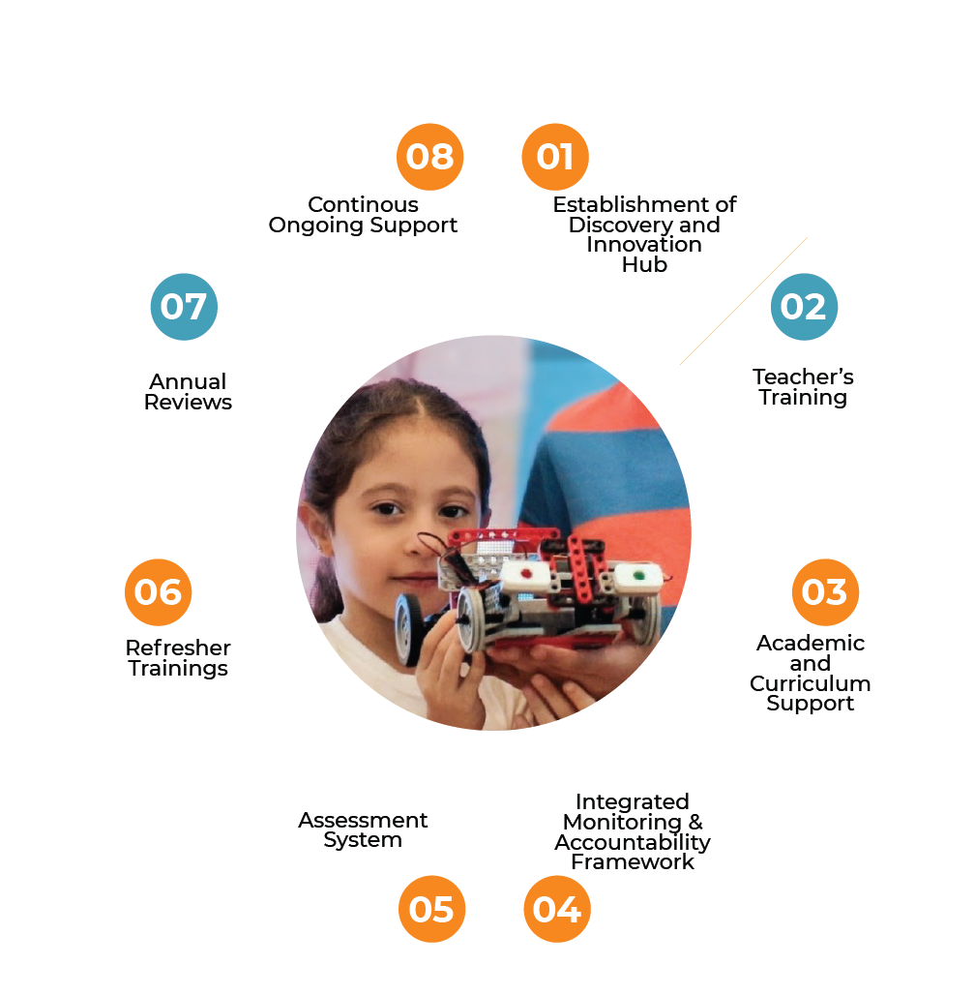
Transforming the Future of Youth
Integration Model:
Integration of emerging technologies such as AI, Robotics, IoT, AR/VR, etc., with existing curriculum of Science and Mathematics.
Addition of Innovation Boxes to prepare students for advanced AI, IoT and programming.
Tailored integrated curriculum with complete academic planning and guideline.
Learning acceleration and Skillset Development.
Assessment system incorporation.
Robotmea PMT (Robotmea online portal) access.

Slide 11
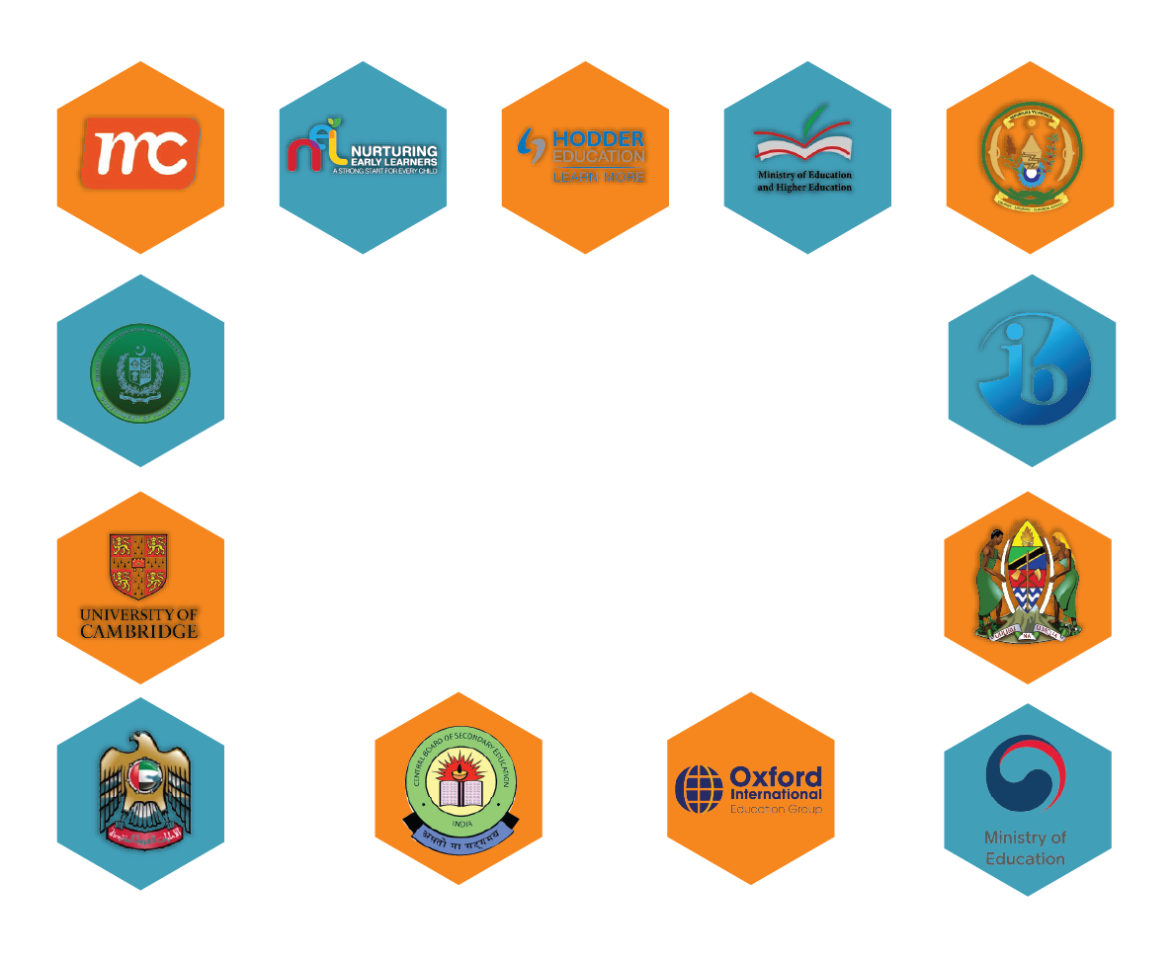
Transforming the Future of Youth

Slide 12
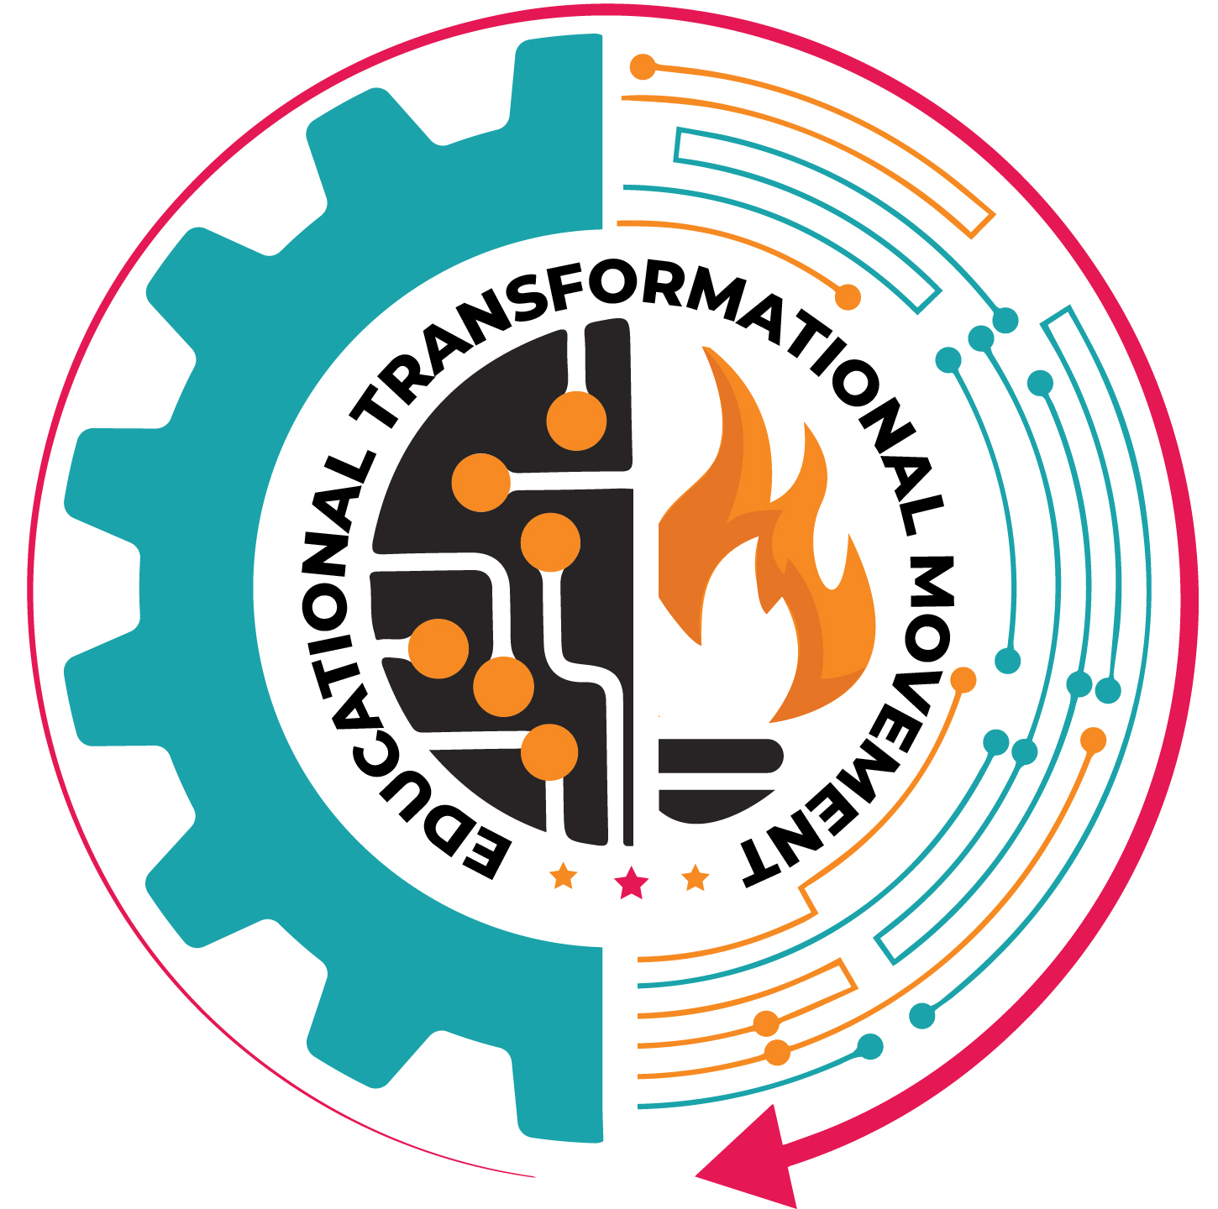
Transforming the Future of Youth
2. Education Transformational Movement (ETM):
Pakistan's first South Korean-based school transformation framework, accredited by Robotron. A 360° turnkey model that shifts schools from transformational to transactional.
• South Korean certified school franchise model.
• SNCP-aligned curriculum.
• No heavy bags, no books, no homework policy.
• AI, Robotics & emerging technology integration.
• Friends of Quran with Arabic subject mandatory and Role Model Program is also embedded in this school program.
• Leadership & faculty development.
• International accreditation pathways.

Slide 13
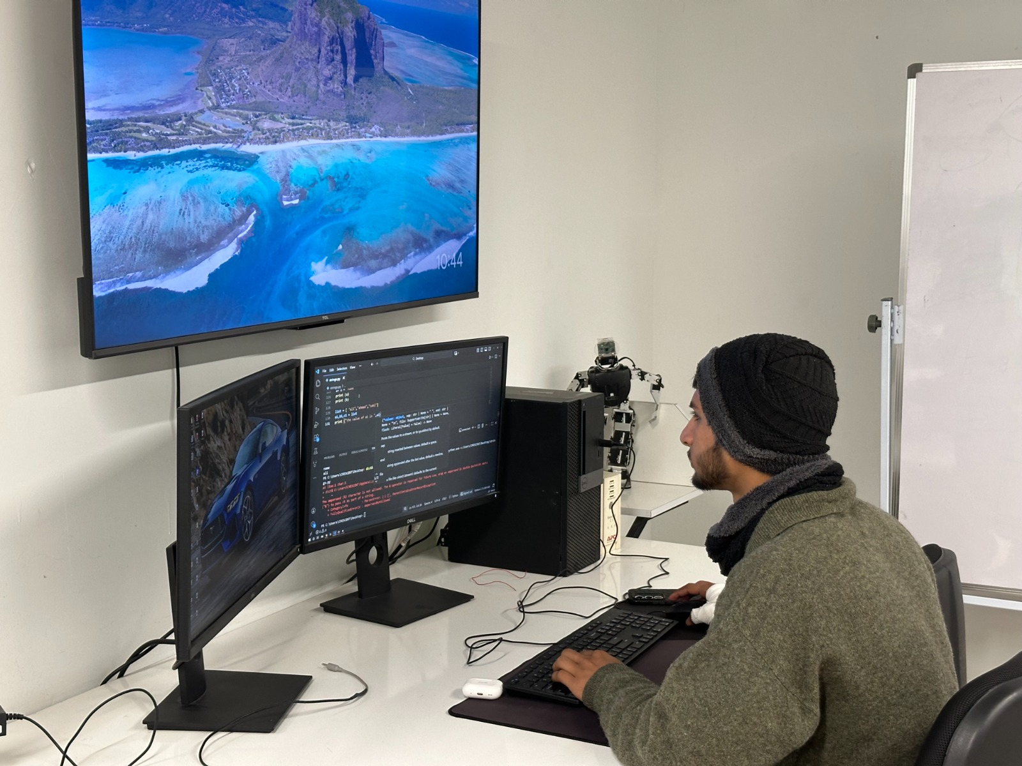
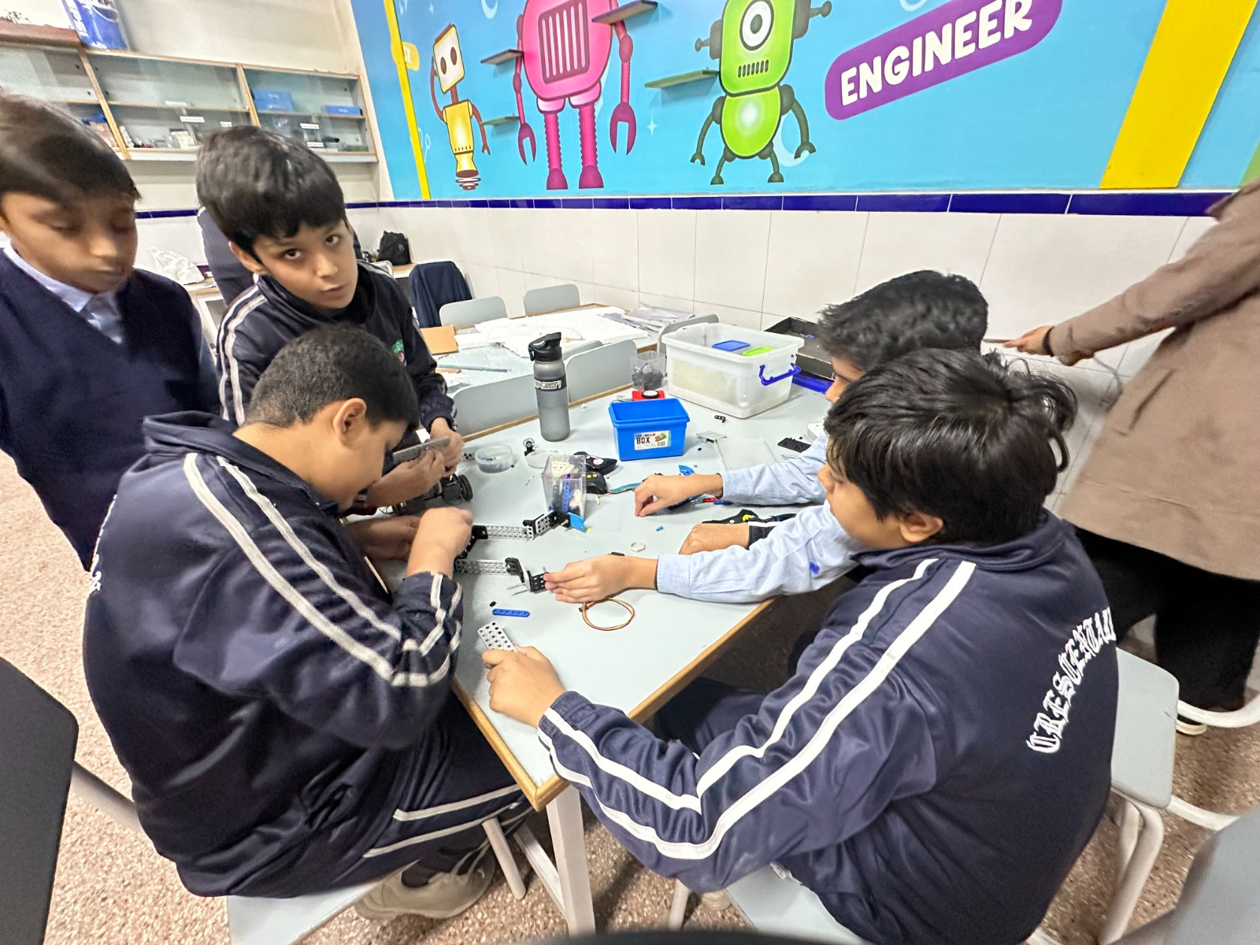
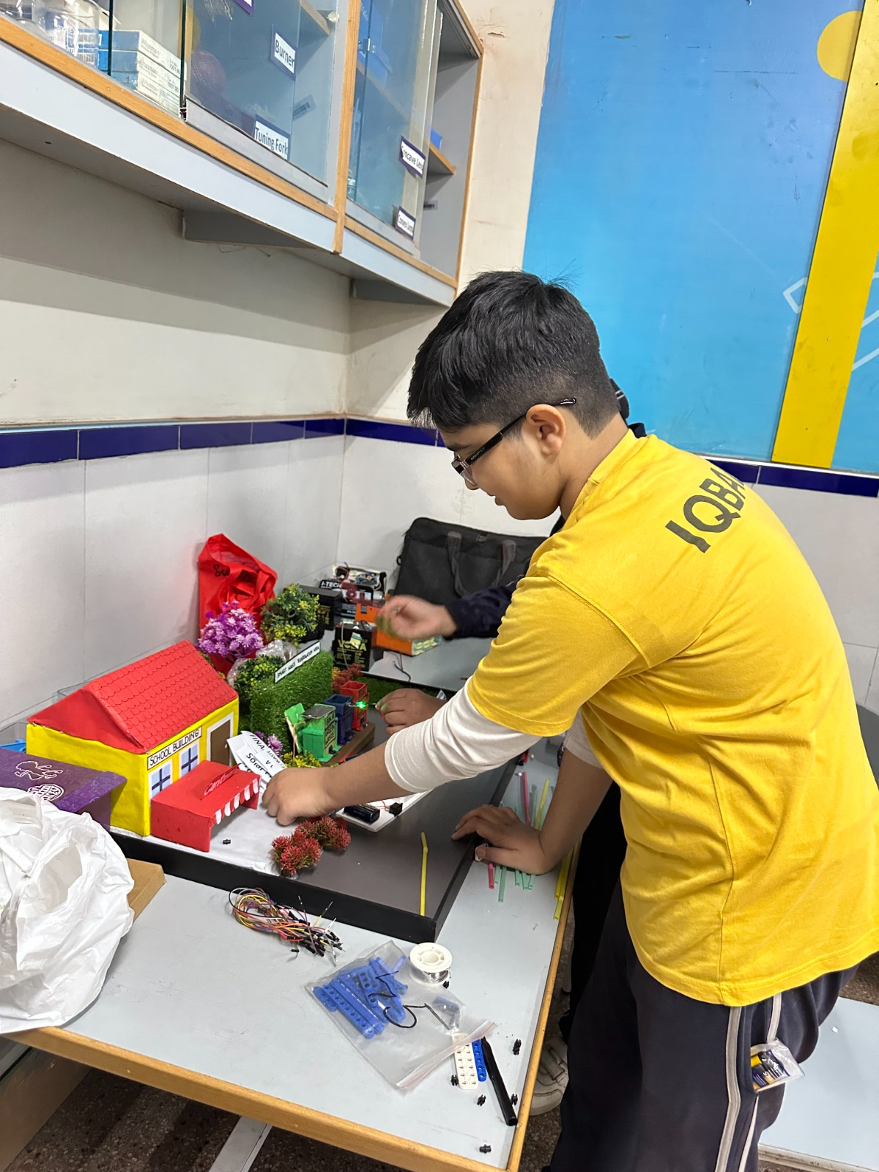
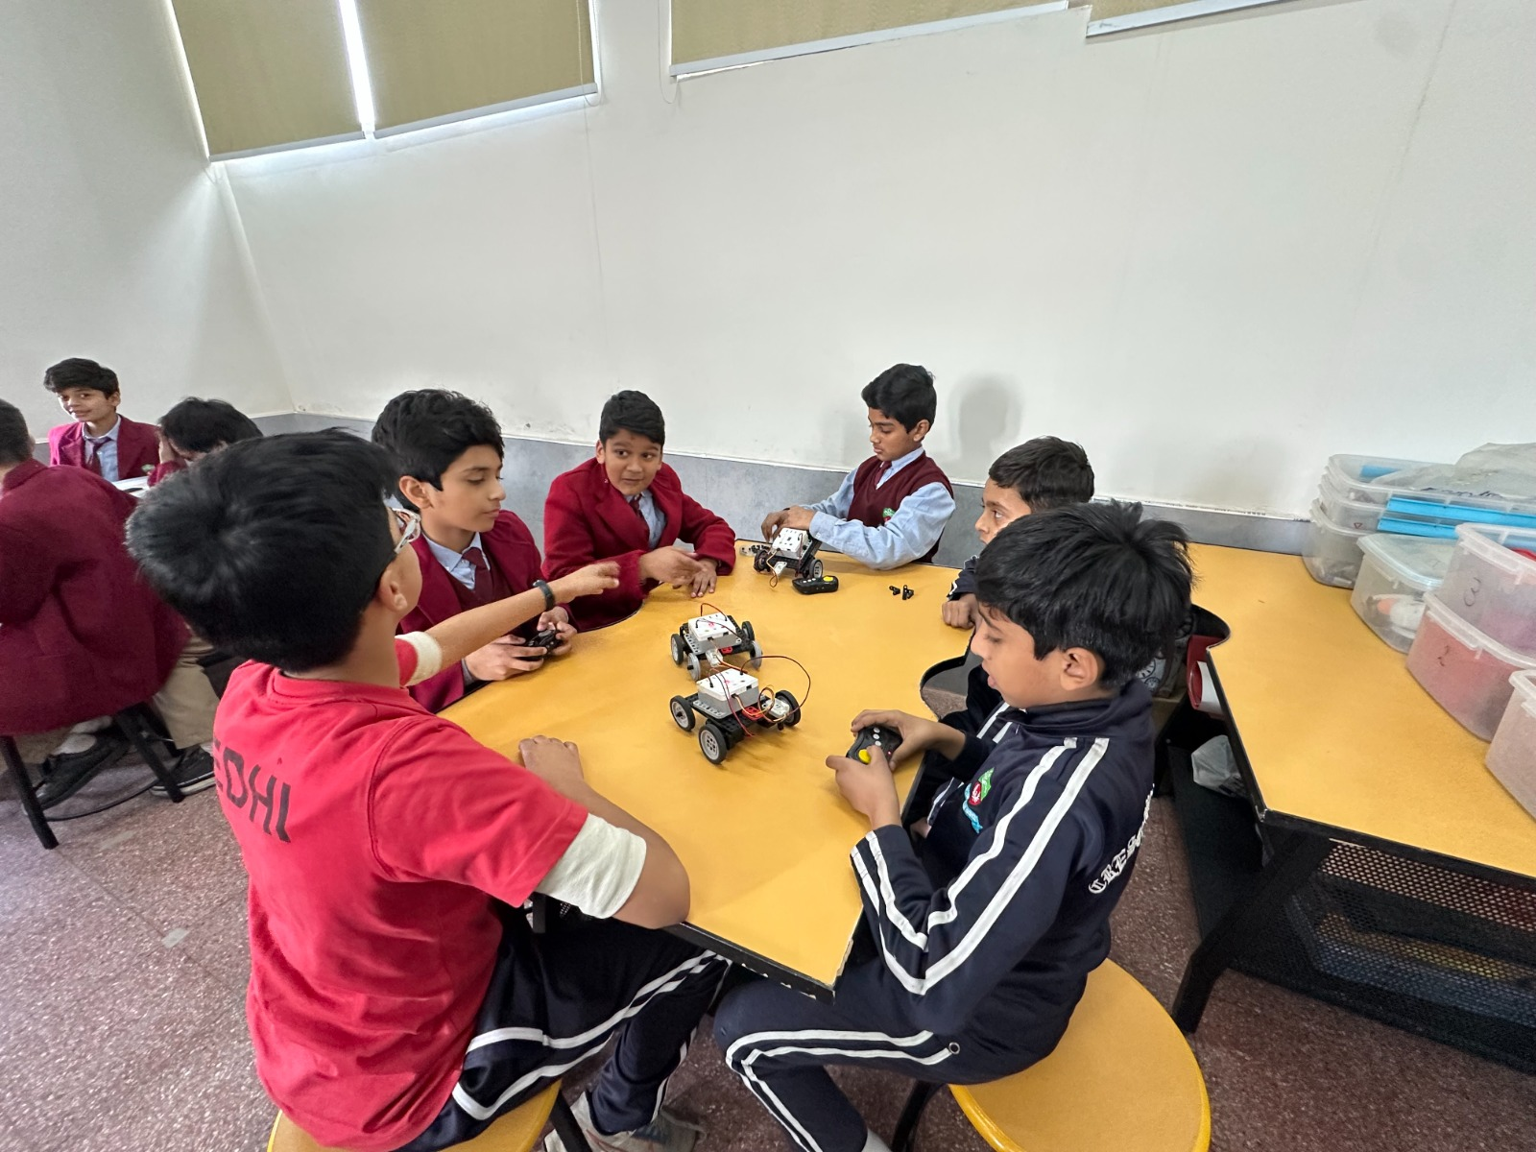
Transforming the Future of Youth
3. Robotmea Emerging Technology Center (RETC):
A state-of-the-art hub bridging education, research and industry academia gap.
• Emerging technologies training (AI, Robotics, IoT, AR/VR, Coding, cyber security, Automation, etc.).
• Research & innovation.
• 3 – 6 months courses.
• Offering 23 courses in Lahore, CETC.
• Industry-aligned skill development.
• Technology incubation & prototyping.
• Certifications & professional development.
• Innovation challenges & competitions.

Slide 14

Transforming the Future of Youth
4. Faculty Development Cell (FDC):
Empowering educators and school leaders with 21st-century teaching skills.
• Teacher training & professional development.
• Educational leadership programs.
• AI, Robotics, STEAM education & emerging technologies.
• Curriculum & assessment innovation.
• International certifications and recognition.
• Continuous Professional Development (CPD).
• International learning and development program and courses.

Slide 15

Transforming the Future of Youth
5. International Diploma Program (IDP):
Globally aligned certifications in emerging fields — 3 months to 3 years.
• Programs in AI, Robotics, IoT, Data Science, Cybersecurity, EdTech, STEAM and emerging technologies.
• Theory + hands-on practical application.
• Globally recognized competencies.
• Clear academic & career advancement pathways.

Slide 16
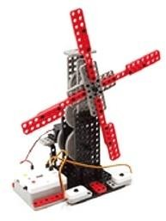
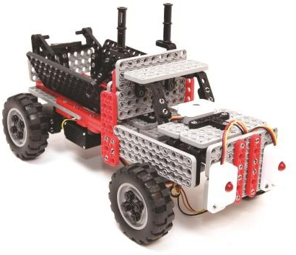
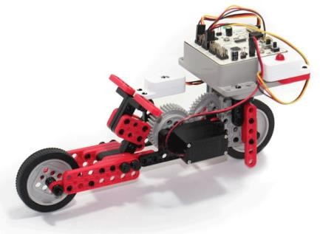
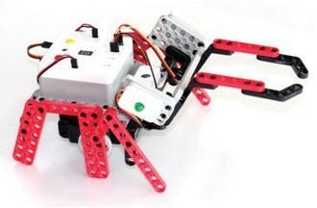
Transforming the Future of Youth
Transforming the Future of Youth
Thank You
Corporate Office Address: Robotmea Edutech Corporate Office, Plot #1, Street #1, Paris City, Block F, Sector H-13, Islamabad, Pakistan
Landline: 0092-51-6128144 | 0092-313 5722409
email: info@robotmea.com, www.robotmea.com

